Slide 1
Getting Started on FT8
By Steve Ford, WB8IMY
QST Editor

Slide 2
What is FT8?
FT8 is a digital communications mode with very good weak-signal performance.
FT8 is NOT a conversational mode; you exchange only call signs, signal reports (in decibels) and grid square designations.
Each transmission is only 13 seconds long.

Slide 3
But Doesn’t Jt65 communicate the same information? What is the difference?
Yes, FT8 and JT65 are the same when it comes to the information exchange.
However, FT8 is much faster with almost the same sensitivity.
A complete JT65 contact takes almost 6 minutes.
A complete FT8 contact takes just 90 seconds.
Unlike JT65, FT8 is semiautomatic. Once an FT8 exchange begins, no operator intervention is necessary.

Slide 4
FT8 is intended for award chasing and propagation research
FT8 appeared in 2017 and it quickly became the #1 digital mode for pursuing DXCC, Worked All States, and other awards.
Thanks to PSKReporter and other online signal-aggregation services, amateurs can easily see who is receiving their FT8 transmissions, and at what signal strengths.

Slide 5
PSKReporter Receiving WB8IMY’s FT8 Transmissions on 40 Meters

Slide 6
What Do You Need to Get Started?
A computer
An SSB transceiver
A computer/transceiver interface (if your radio requires one)
WSJT-X software

Slide 7
Any modern Computer is adequate for FT8
However, the faster the better since a fast machine can decode much more quickly.

Slide 8
Most modern ssb transceivers are good for ft8 as well.
For FT8 the key is frequency stability. If your transceiver drifts too much, you won’t be able to decode signals – and others won’t be able to decode you!

Slide 9
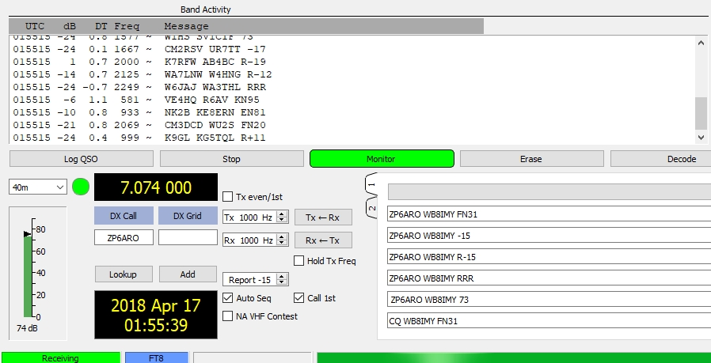
Time is Critical as well
Your computer clock must be accurate to within about 2 seconds or you won’t be able to decode FT8 signals, or vice versa. Notice the “DT” column below, which indicates the time disparity between stations. R6AV is 1.1 seconds out of sync, which is getting close to becoming excessive.

Slide 10
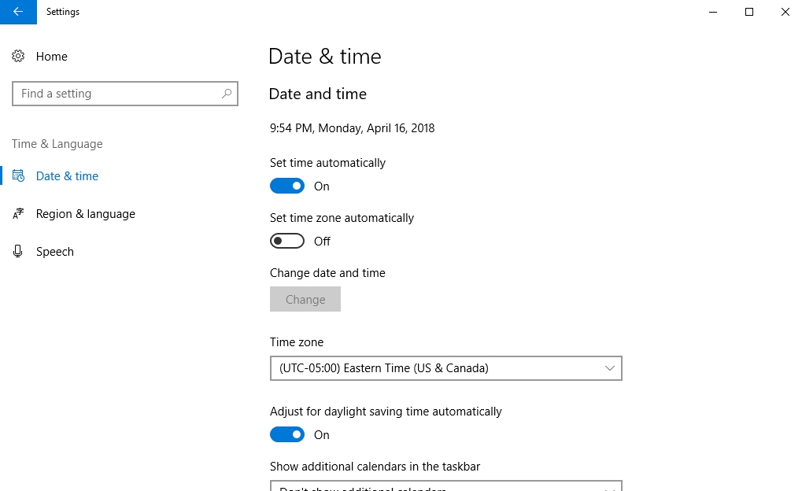
Most computer Clocks “Drift”
Force Windows to recalibrate its time
Or use software such as Dimension4 to keep your computer time in sync.

Slide 11
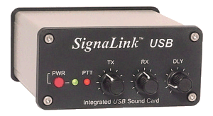
Interfaces
Almost any interface will do. Also, several transceiver models will now interface directly to your computer without the need for another device.

Slide 12
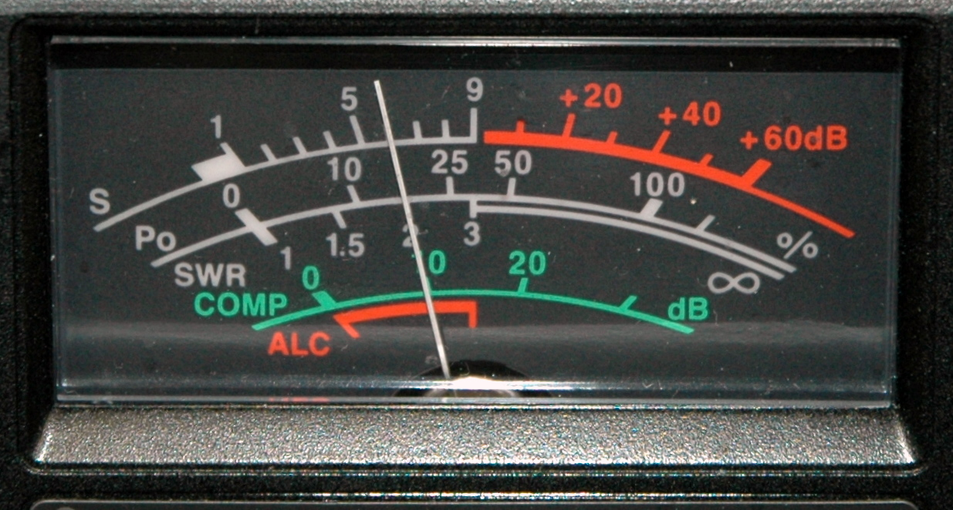
Be careful not to overdrive your radio Reduce Transmit audio if you see too much ALC activity

Slide 13
WSJT-X Software
FT8 is part of K1JT’s WSJT-X software suite.
It is free and available for Windows, Mac OS, and Linux
https://physics.princeton.edu/pulsar/k1jt/wsjtx.html

Slide 14
An FT8 Demonstration – Double Click to Access YouTube and then click the Play ARRow to Watch the Video

Slide 15
For more information, pick up the second edition of ARRL’s Get on the air with HF digital

